Slide 1
AR Blackjack Assistant
Remote Rendering Application
Team: ARAnnihilators
Membership: UCCS
Faculty Sponsor: Bill Michael
09/16/2022

Slide 2
OUTLINE
Description of solution concepts
Comparison of solution concepts to problem requirements
Decision matrix
Concept recommendation
Plan to complete the design
Test Plan
Introduction
Methodology and procedure
Results and analysis

Slide 3
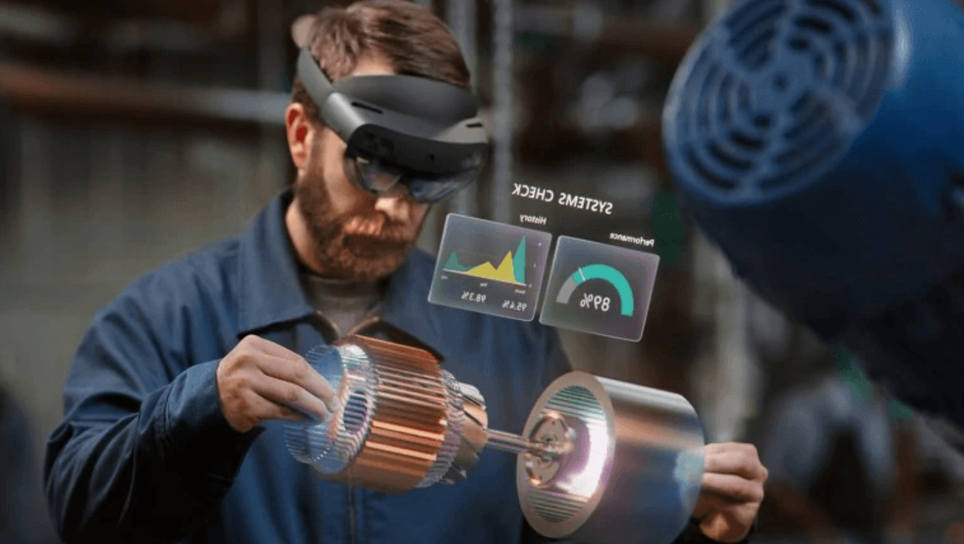
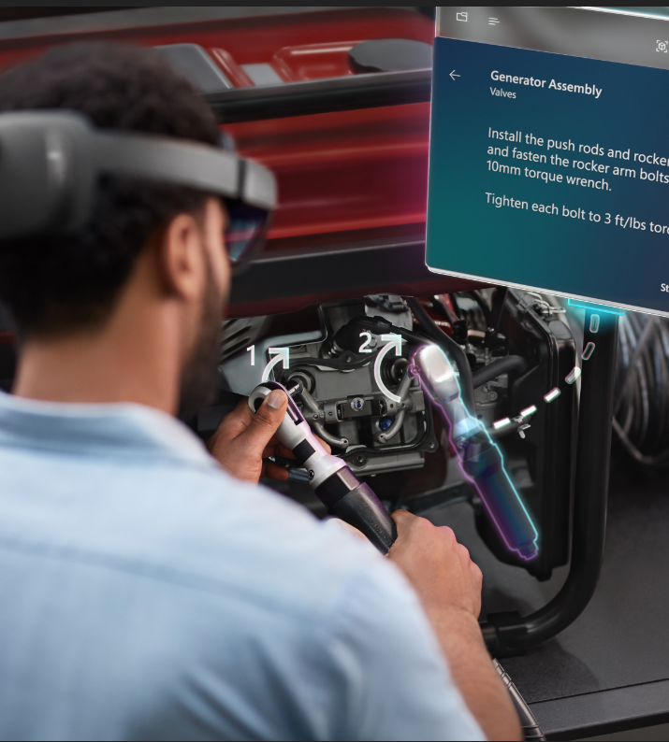

DESCRIPTION OF SOLUTION CONCEPTS
The primary solution is customized towards achieving a higher quality player’s game for unskilled gamers. This will be realized with the addition of visual effects such as:
Overlays
Player Performance Statistics
Object Identification
Audio Effects

Slide 4
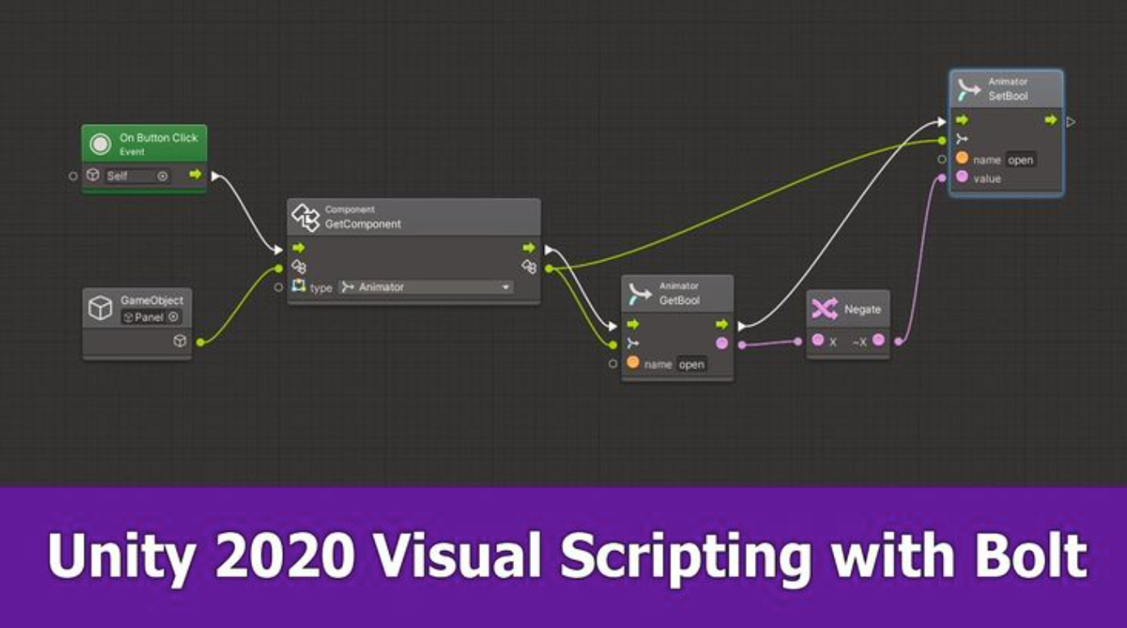
DESCRIPTION OF SOLUTION CONCEPTS: UNITY ENGINE
Parent Class
Actor
Child Class
Component
Child Class
Component
Child Class
Component
Audio Effects
Overlays
Color

Slide 5

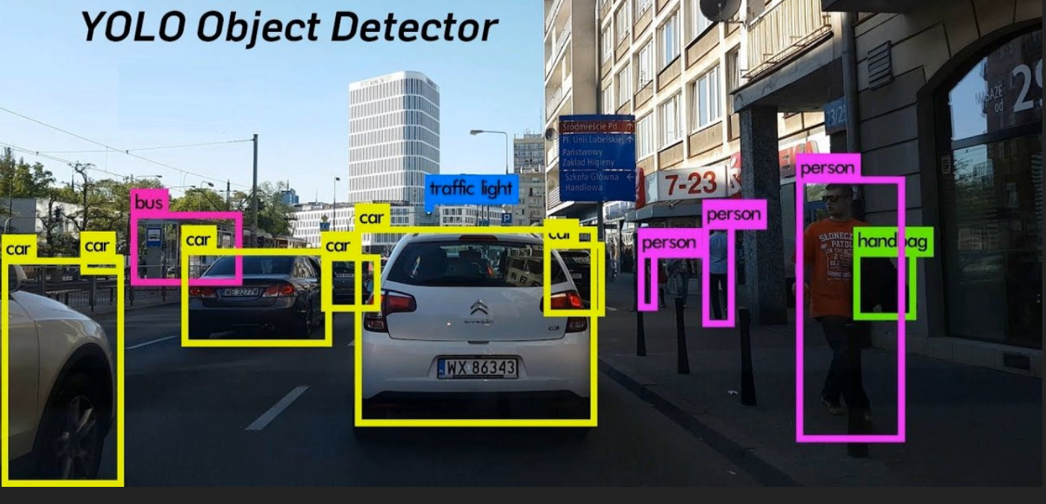
DESCRIPTION OF SOLUTION CONCEPTS: YOLO

Slide 6
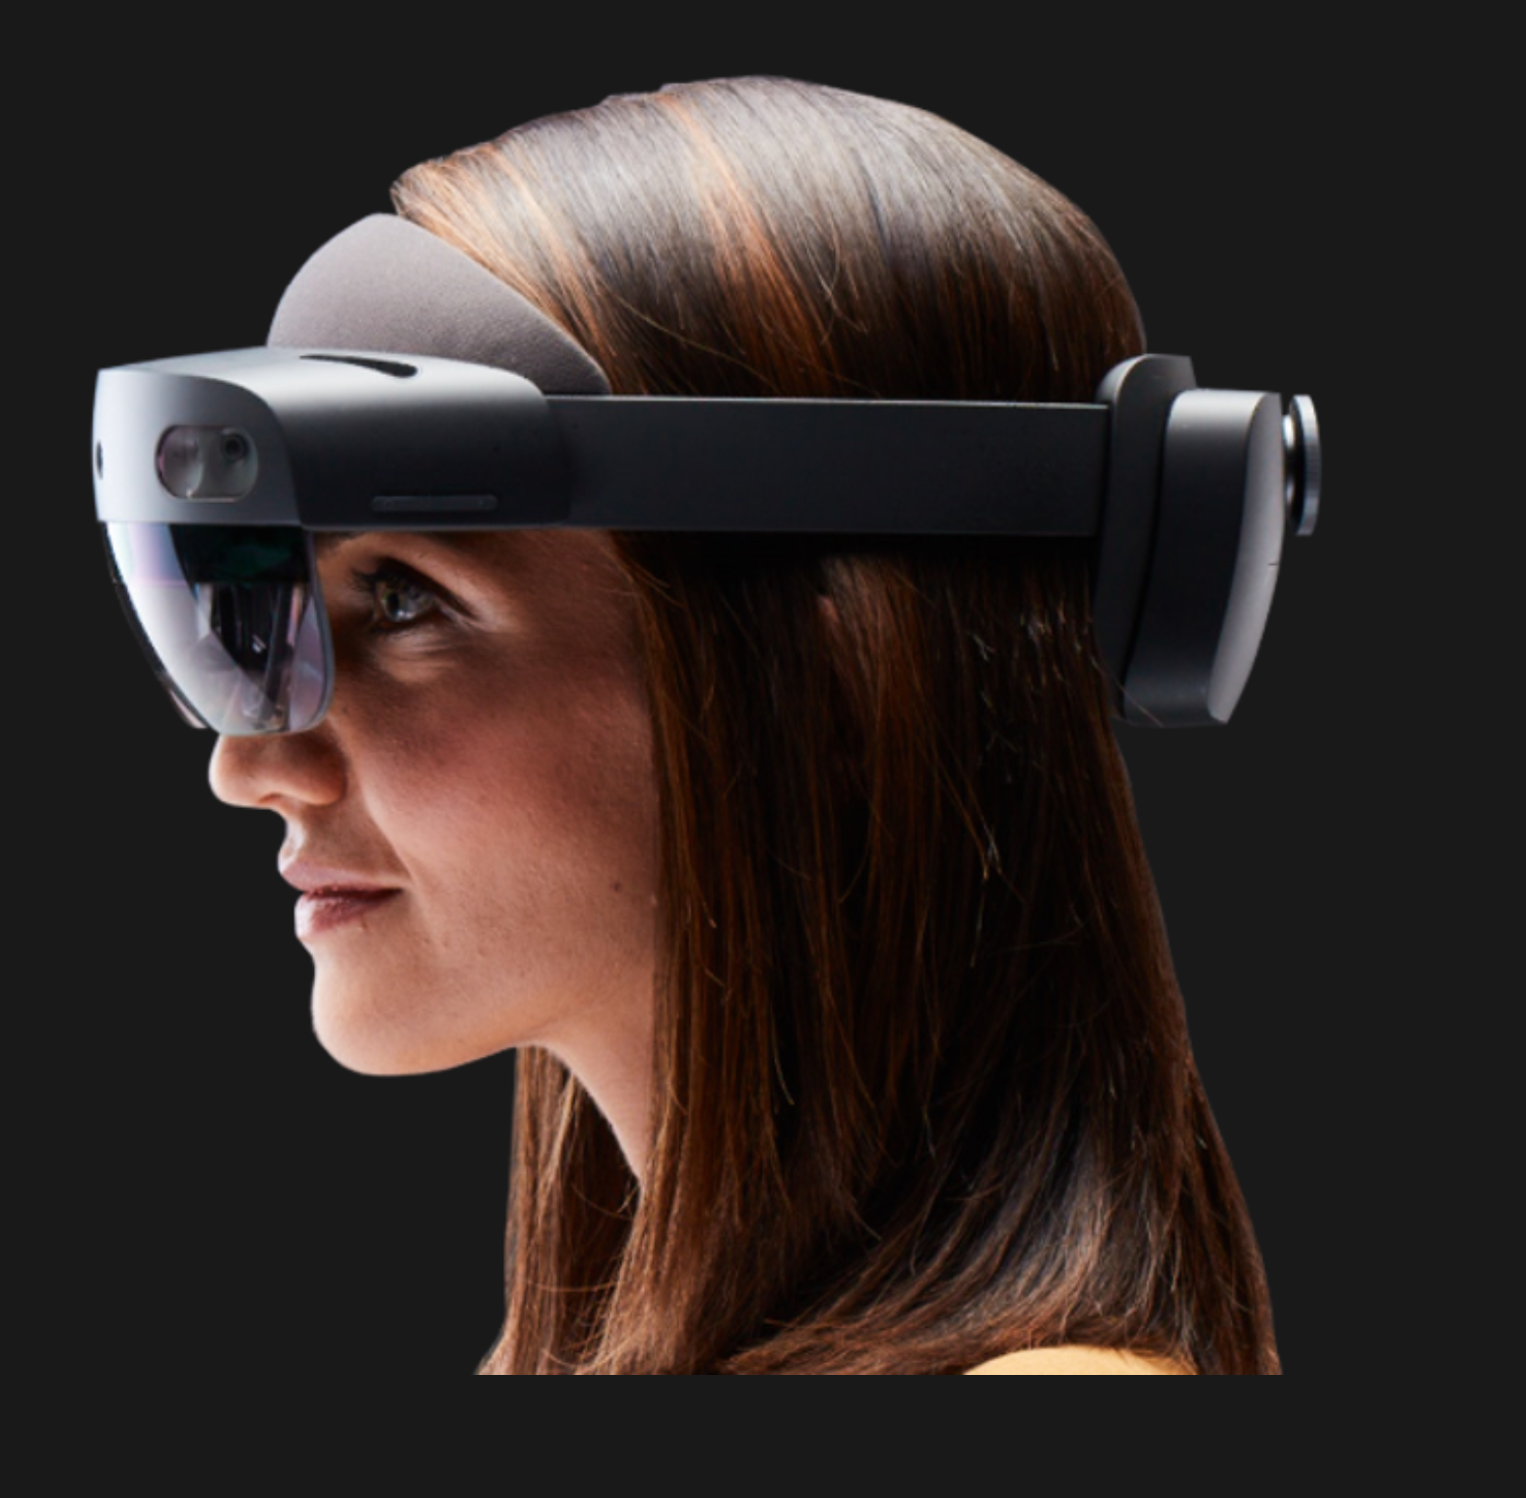
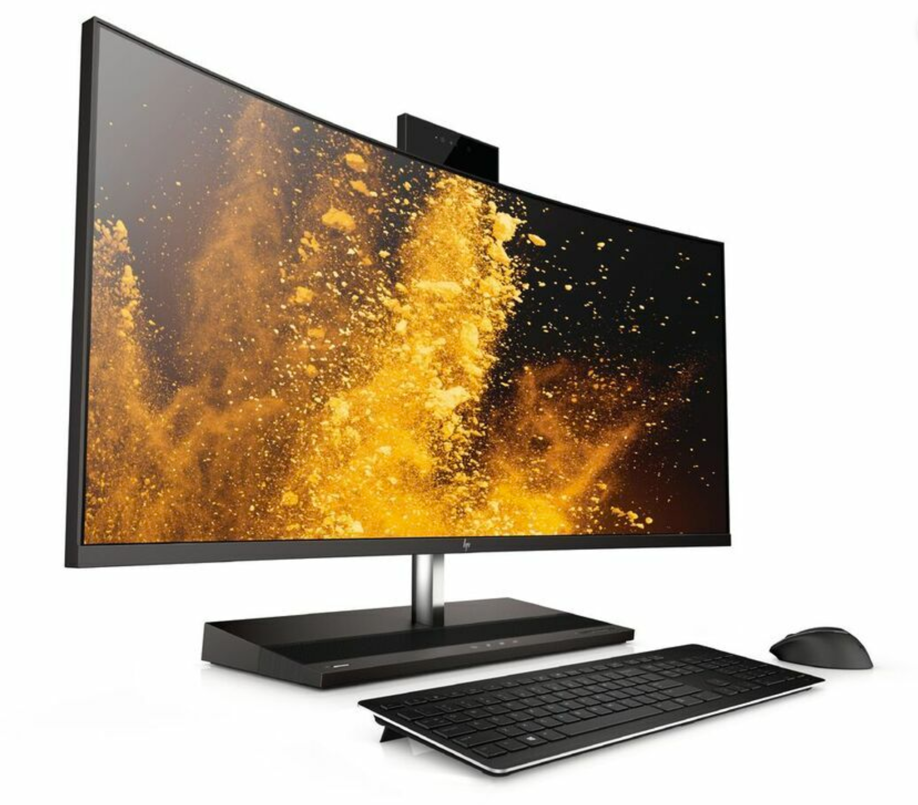
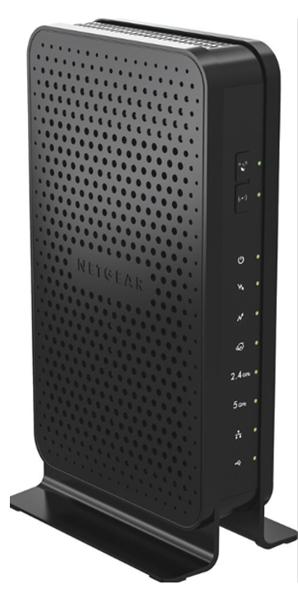


DESCRIPTION OF SOLUTION CONCEPTS
The Secondary solution is towards the device’s performance which includes:
The Memory
Battery Life
Management App
Runtime

Slide 7
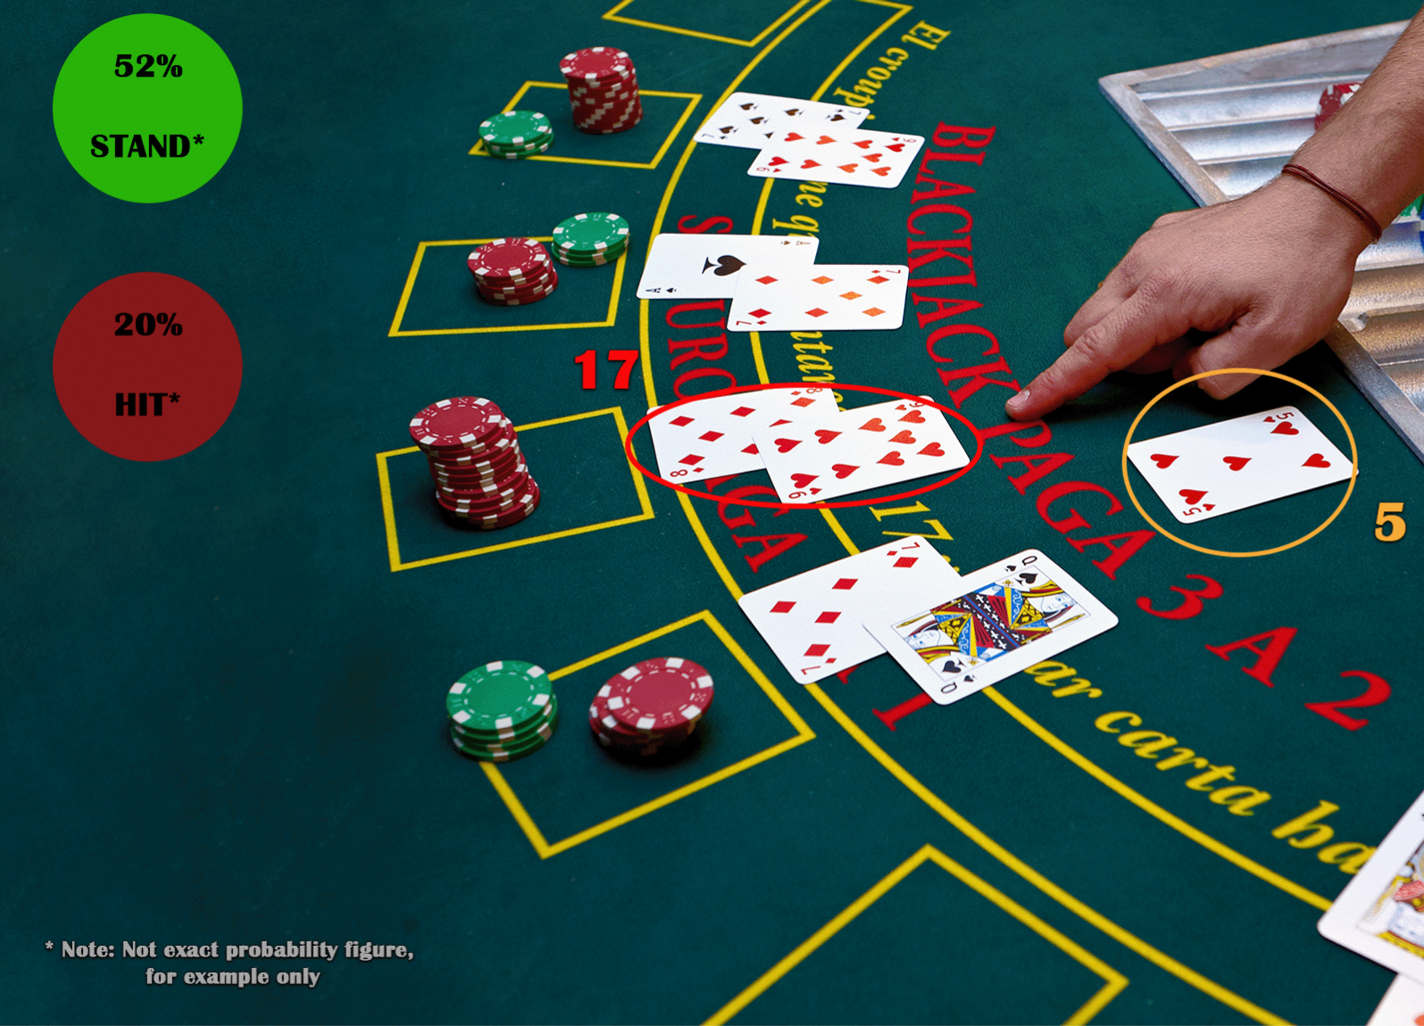
COMPARISON OF SOLUTION CONCEPTS TO PROBLEM REQUIREMENTS
WiFi Connection -> Python TCP
App rendering -> Unity
Battery Runtime Improved
Object Detection -> YOLOv3
Probability Functions -> Python

Slide 8
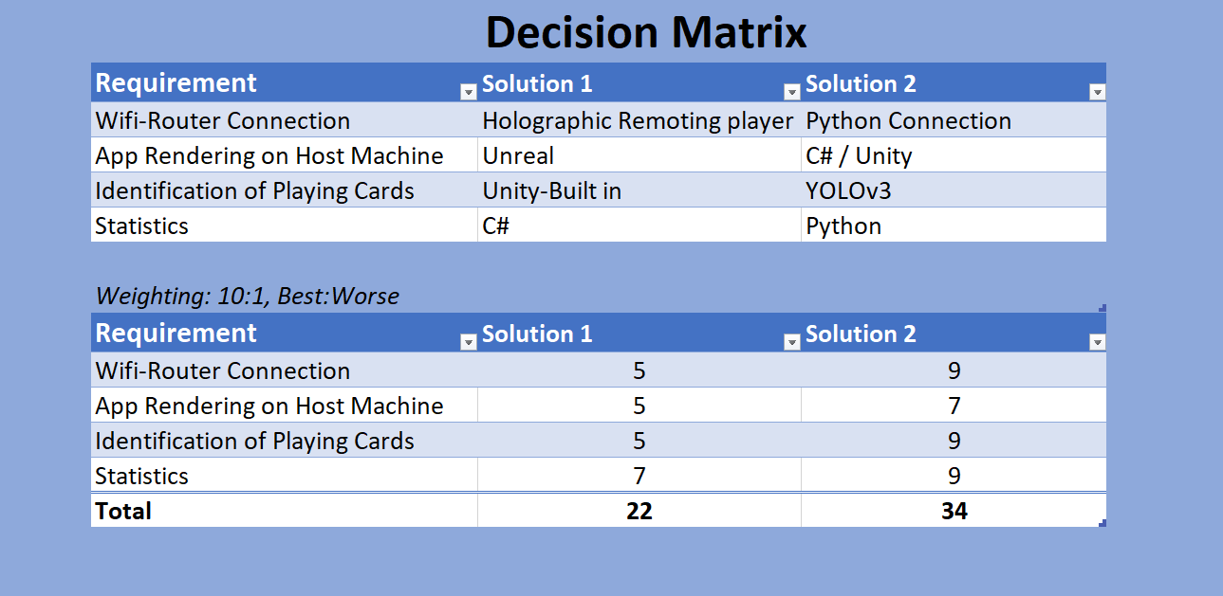
DECISION MATRIX SLIDE

Slide 9
CONCEPT RECOMMENDATION
YOLOv3 vs Unity Built-In for Object Detection
YOLOv3 is top-scoring solution.
YOLOv3 is a more dependable way to detect the playing cards.
Unity built-in tools may not have a way to do object-detection.
Weight: 9

Slide 10

CONCEPT RECOMMENDATION
Unity for App Processing vs Unreal
Using Unity seems to be more simple option.
Unity has many tools to build graphics/functionality for the app.
YOLOv3 is compatible with Unity.

Slide 11

CONCEPT RECOMMENDATION
TCP Python server vs Holographic Remoting player for Wi-Fi
TCP with a python server will be used over Holographic Remoting player.
The python server uses Wi-Fi and a TCP connection to send data between Python and Unity.
Holographic Remoting player is to deploy an app to the Hololens via Wi-Fi.

Slide 12

CONCEPT RECOMMENDATION
Statistics using Python vs C#
Python is a a more simple programming language and will be used to perform the probability statistics for the app.
The same can be done with C#, but Python is chosen because it will have the TCP Server and client interfaced with Unity.

Slide 13
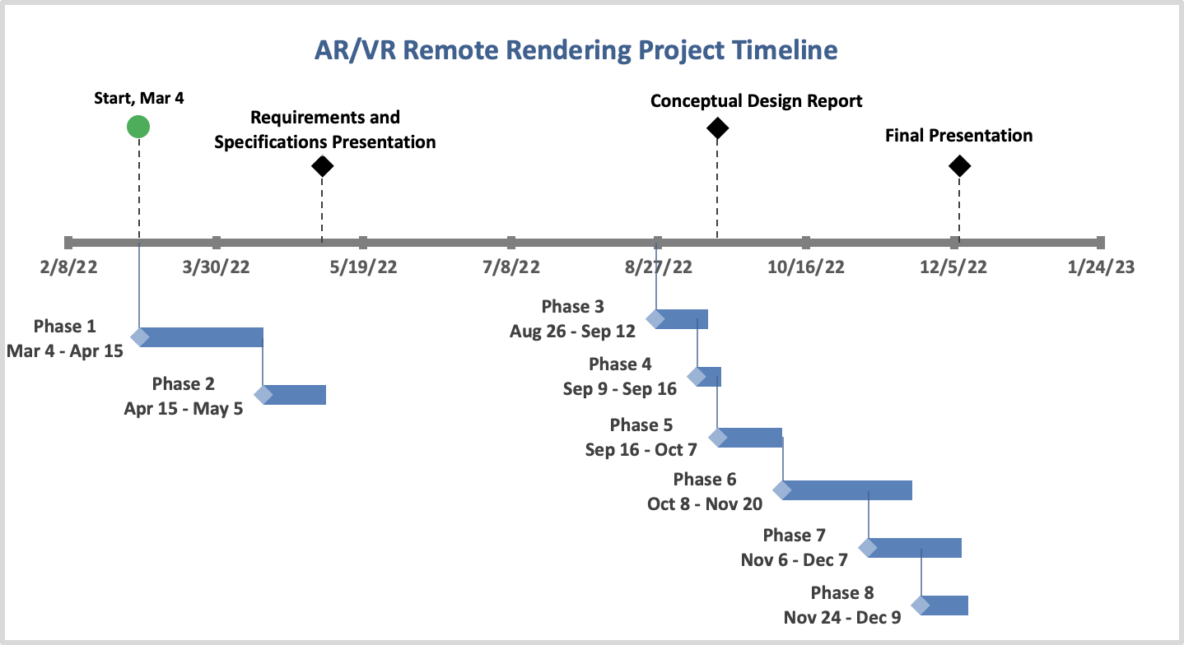
PLAN TO COMPLETE THE DESIGN
October 7 : Critical Design Documents Finalized
November 6: Application Finalized
November 20: Testing Completed
December 6: Final Design Package Finalized
December 7: Testing Report Finalized
Notes:
Our project has and will go through several different phases during its lifetime. Currently, we are in phase 4. Before the completion of the semester we will hit two more milestones including finalizing the Conceptual Design Report and presenting out final design package. Some other important deadlines coming up include October 7 which will be the finalization of our Critical Design Documents, November 6 where we will have our finalized application, November 20 which will mark the completion of testing and finally December 7th when our team will have a finished Testing Report. Two the right we have our project’s timeline, including all the phases and milestones.

Slide 14
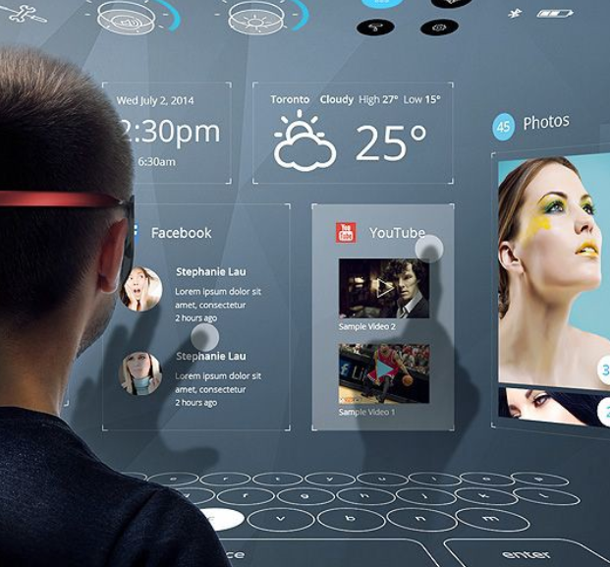
TEST PLAN INTRODUCTION
The test plan is a verification process that demonstrates the software and hardware features of the AR/VR device functioning correctly.
Once the hardware and software have been fully assessed, user interaction is something that will need to be tested to fulfill the projects overall mission.

Slide 15
TEST PLAN METHODOLOGY AND PROCEDURE
Set up HoloLens to use Windows Device Portal
Connect to HoloLens over Wi-Fi
Install Certificate
Instantaneous System Performance Readings
Perform a trace
Notes:
As mentioned many times before our project will be testing our AR remote rendering application utilizing a HoloLens 1 and a host computer. The procedure for testing our system and application will start with setting up the HoloLens to use the Windows Device Portal. Then the tester will need to connect to HoloLens over Wi-Fi and install the certificate. This will allow us take instantaneous system performance readings, as well as perform traces. Once a trace has been performed, the team will have an ETL file that can be opened directly with WPA.

Slide 16
TEST PLAN RESULTS
Data Collected | Reason
SoC Power and System Power | Collected to view how much power is being used while each application is being used
Frame Rate | Collected to view how fast the communication is between each application and the hololens
GPU, CPU, Memory Usage | Collected to see the efficiency of each application
Notes:
In our traces we will be focused on System-on-Chip power and System power usage, Frame rate, GPU, CPU and Memory usage. This data will tell us how much power is being used, how fast the communication is, and how efficient our application is. To have a good benchmark, we will test our app as both remote and non-remote rendering.

Slide 17
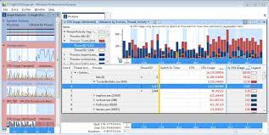
TEST PLAN ANALYSIS
Analyze the trace with WPA
Windows Performance Analyzer is the standard tool to visualize traces as graphs and tables to all you to analyze the system and application performance
Notes:
In order to analyze our traces, our team will be using the Windows Performance Analyzer or WPA for short. This software will allow us to visualize our traces as graphs and tables. To the right is an example of this software being used to analyze a systems performance.

Slide 18
Any questions?

